Slide 1
Sickle Cell Classification Using Deep Learning:
Final project presentation
Presented by: Jordan Mozebo
Professor: Dr. Lettu Qingge –Assistant Professor in the Department of Computer Science

Slide 2
CONTENT:
Introduction
Background
Methodology
Results
Discussion
Conclusion
References

Slide 3
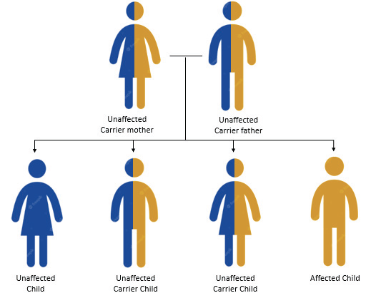
INTRODUCTION
Sickle cell disease is an inherited condition caused by genetic mutations [1].
Sickle cell disease affects hemoglobin in red blood cells [1].
Manual identification is time-consuming and error-prone [2].
fig 1: Inheritance Of Sickle Cell Disease

Slide 4
BACKGROUND
AI techniques are promising in medical image analysis.
Deep learning extracts features automatically from images.
Lightweight models like MobileNet_v3 are efficient and fast.

Slide 5
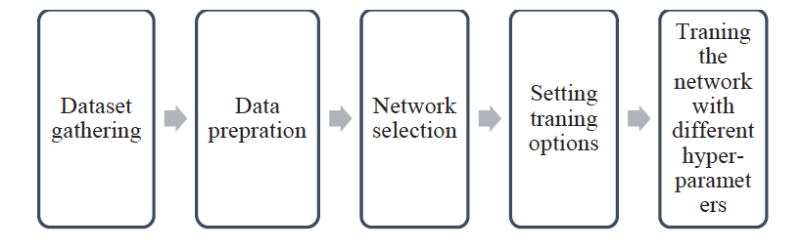
METHODOLOGY
Workflow involves training a custom MobileNetv3.
Fig 2: Workflow

Slide 6
Methodology
Dataset:
University College of London sickle cell dataset
1971 images
Data preparation:
Converted from .tiff to jpeg format
Images were flipped horizontally and rotated to add variability
75% for training, 25% for validation to ensure balanced data distribution
Model architecture:
Depthwise separable convolution for feature extraction with fewer parameter
Squeeze-Excitation blocks enhance important features
Swish activation to improve the gradient flow and non-linearity
Final classification 1280x2 outputs logits for binary classification

Slide 7
Methodology (continued)
Training process:
Used Adam optimizer for adaptive learning rates, efficient convergence, and handling sparse gradients in deep networks like MobileNetV3, with weight decay (1e-4) for regularization.
Employed backpropagation to compute gradients for parameter updates during training.
Chose a batch size of 32 to balance memory constraints and ensure stable gradient updates.
Trained the model for 50 epochs to allow convergence and enable effective learning rate scheduling.

Slide 8
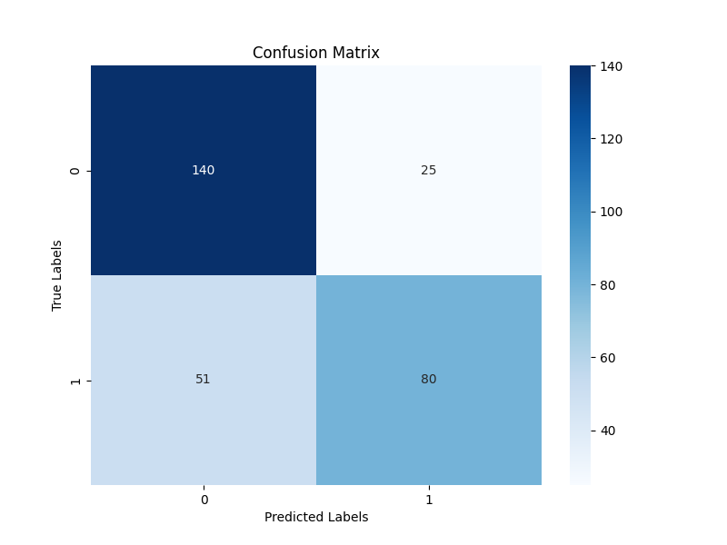
RESULTS
The custom MobileNetv3 achieved 74.32% validation and 71.43% testing accuracy

Slide 9
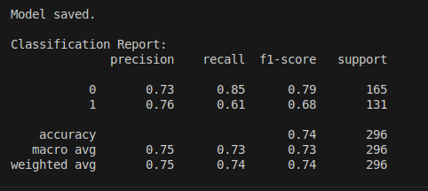
Classification Report

Slide 10
Discussion
The model performs moderately well and shows clear learning capability.
It is more effective at detecting normal cell than sickle cell.
Achieves 74% accuracy with strong and balanced performance on class 0 (precision: 0.73, recall: 0.85, F1: 0.79).
Lower recall for sickle cell (0.61) suggests the model struggles to correctly identify sickle cell, possibly due to class imbalance.
Improvement is needed in capturing sickle cell instances.

Slide 11
CONCLUSION
Deep learning automates and improves cell classification accuracy.
Transfer learning reduces training data and time.
Ethical considerations and robust validation are essential.

Slide 12
REFERENCES
[1] Ashley-Koch, A., Yang, Q., & Olney, R. S. (2000). Sickle hemoglobin (HB S) allele and sickle cell Disease: A HUGE review. American Journal of Epidemiology, 151(9), 839–845. https://doi.org/10.1093/oxfordjournals.aje.a010288
[2] Goswami, N. G., Goswami, A., Sampathila, N., & Bairy, G. M. (2023). Sickle Cell Classification Using Deep Learning. 2023 3rd International Conference on Intelligent Technologies (CONIT), 1–6. https://doi.org/10.1109/conit59222.2023.10205802 [3] Howard, A., Sandler, M., Chen, B., Wang, W., Chen, L., Tan, M., Chu, G., Vasudevan, V., Zhu, Y., Pang, R., Adam, H., & Le, Q. (2019). Searching for MobileNetV3. 2021 IEEE/CVF International Conference on Computer Vision (ICCV), 1314–1324. https://doi.org/10.1109/iccv.2019.00140

Slide 13
THANK YOU!

